Slide 1

WAY TO ENTERPRISE
AWS
VTI ACADEMY
Author: duy.nguyenngoc1@vti.com.vn

Slide 2
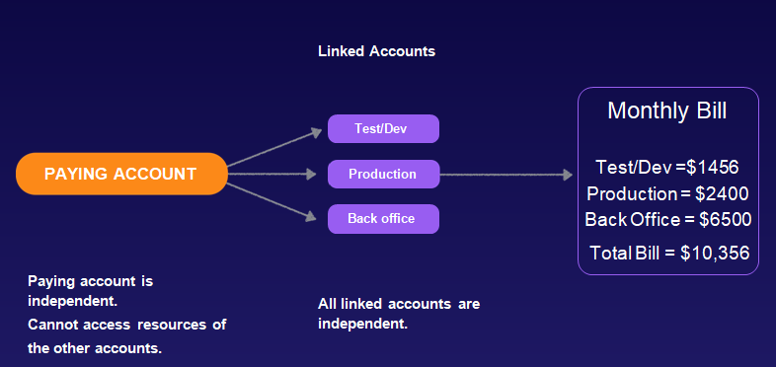
Organizations Service
Allows to manage multiple AWS accounts
Consolidated Billing across all accounts - single payment method
Pricing benefits from aggregated usage (volume discount for EC2, S3…)
Global service
Price: free
Consolidated billing

Slide 3
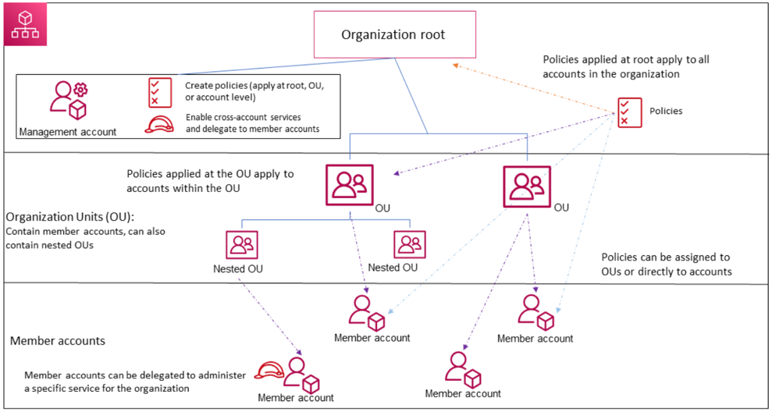
Organizations Service
Components
  Organization Root
  Organization Unit (OU)
  Management Account / Member Account
  Service Control Policy (SCP)

Slide 4
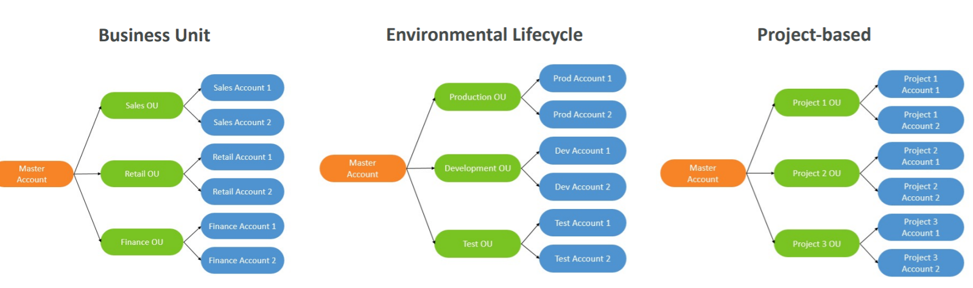
Organizations Service
  Organization Unit (OU)
    Support nested OU
OU: Department, Development Environment, Project, ...

Slide 5
Organizations Service
  Account (Not IAM User)
    Member Account
      Each account will have its own billing and resources
      Only join 1 organization at a time
    Management Account
      All billing of member accounts will be charged to management account
      Only login when performing tasks related to management account (add, edit, remove, ...), pay billing

Slide 6
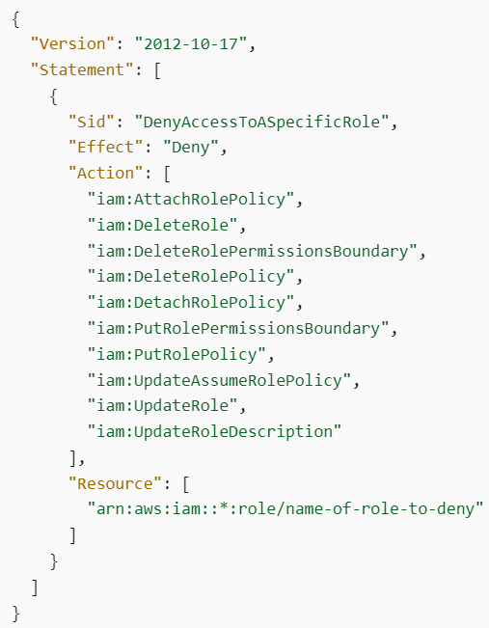
Organizations Service
  SCP
    Manage permissions for OU, Member Account
    Applied at the OU or Account level
    Does not apply to the Master Account
    SCP is applied to all the Users and Roles of the Account (including Root user)
https://docs.aws.amazon.com/organizations/latest/userguide/orgs_manage_policies_scps_examples.html
Similar to IAM Policy

Slide 7
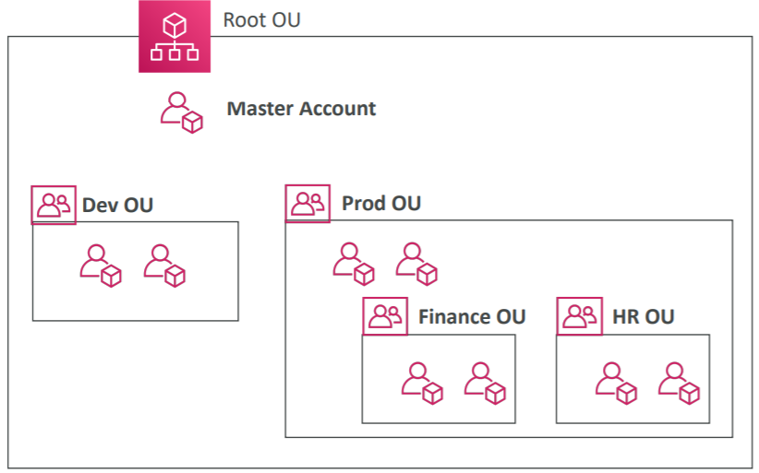
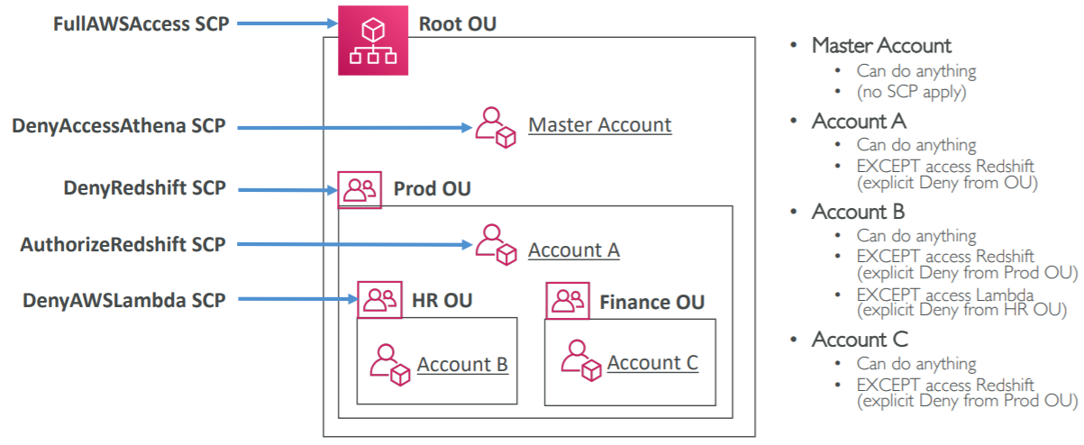
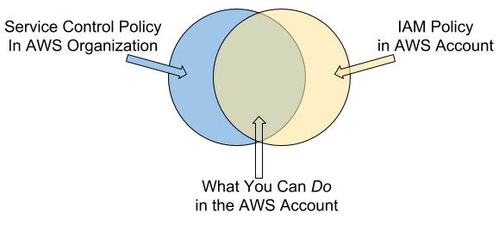
Organizations Service
SCP Hierarchy
Organization policy & IAM user policy

Slide 8
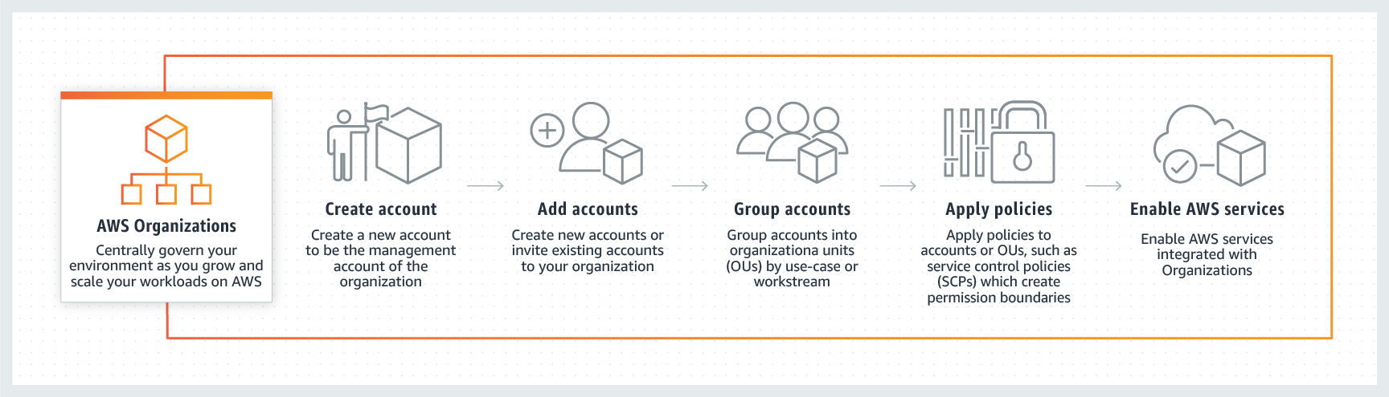
Organizations Service
Demo
  Create Organization
  Create OU
  Add member account to OU
  Create & attach policy to OU, Member Account
https://docs.aws.amazon.com/organizations/latest/userguide/orgs_tutorials_basic.html

Slide 9
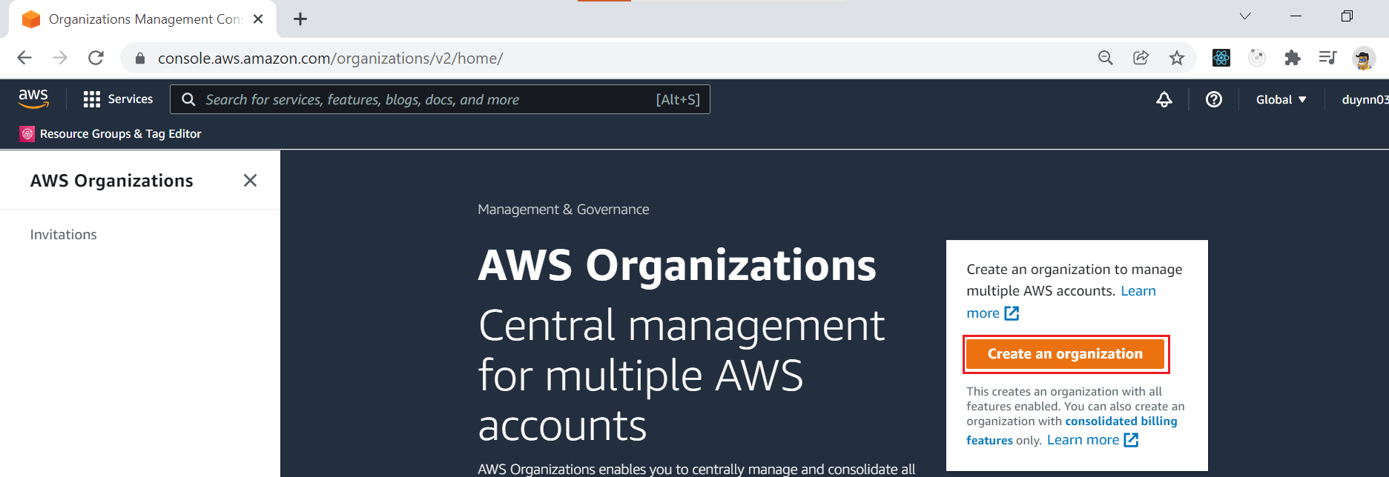
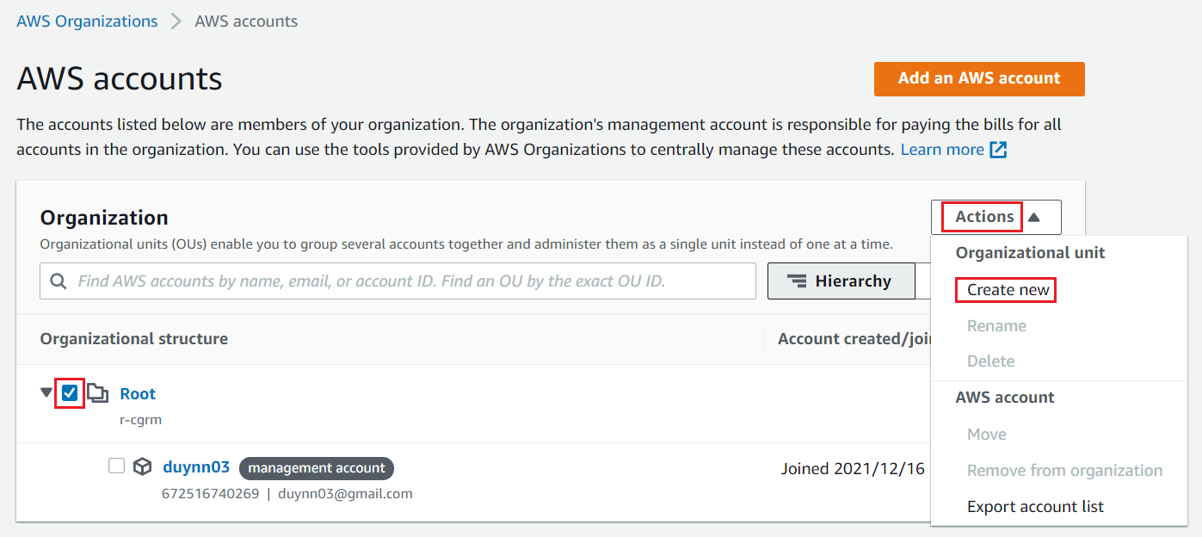
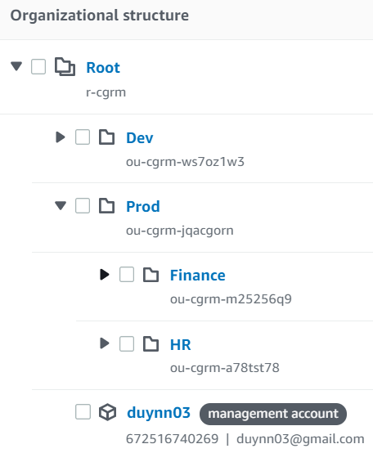
Organizations Service
Create Organization
Create OU

Slide 10
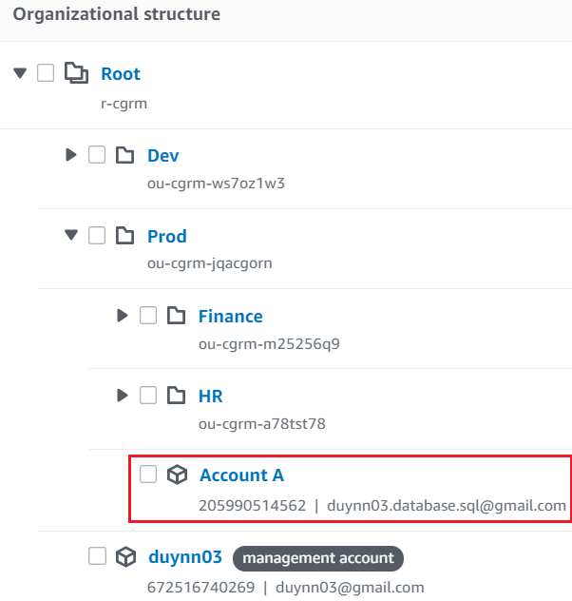
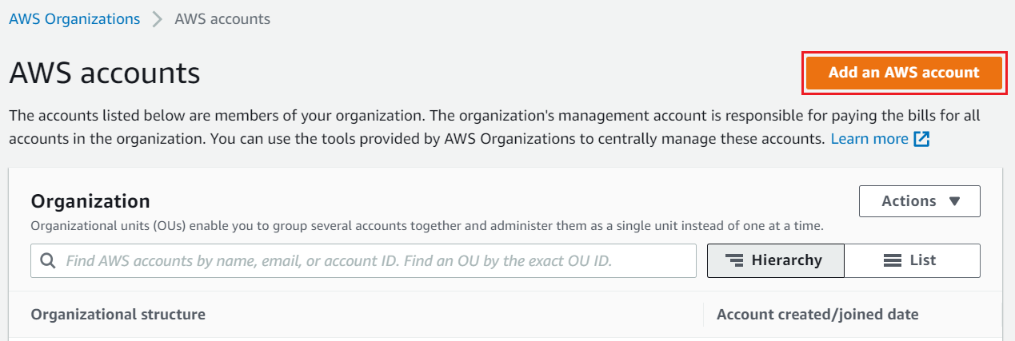
Organizations Service
Add member account to OU

Slide 11
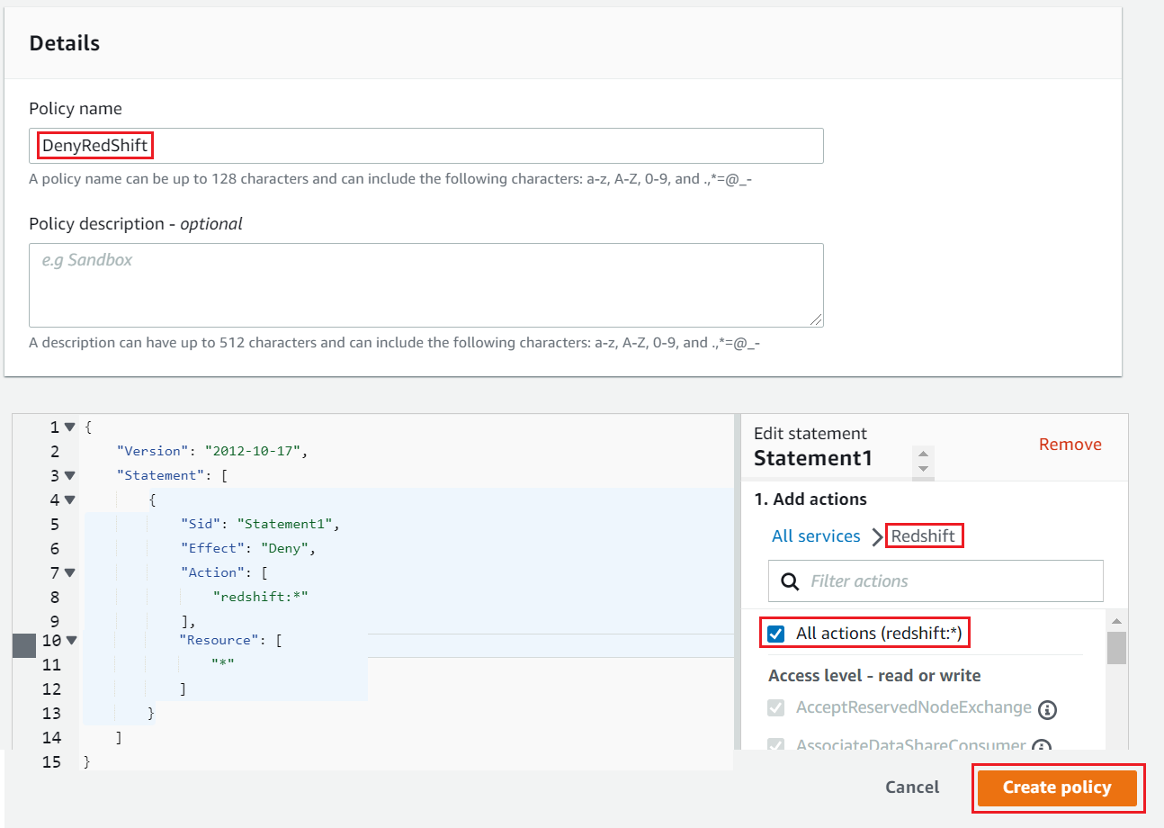
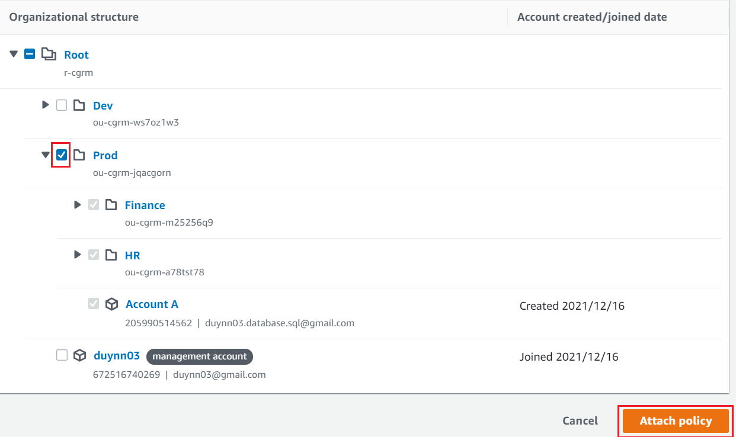
Organizations Service
Create & attach policy to OU, Member Account

Slide 12
Organizations Service
  Accessing member account
    https://www.youtube.com/watch?v=lMUvzJlkoKs

Slide 13
Assignment
  Self-practice

Slide 14
Summary
Components: Organization, OU, Management Account, Member Account, SCP
Consolidated Billing (Voucher)
Global service, Free

Slide 15
Assignment

Slide 16
Quiz

Slide 17
Reference
https://docs.aws.amazon.com/

Slide 18
Q & A
Copyright © VTI Academy All Rights Reserved

